Slide 1
Topic: application of addition to perimeter EQ: How do you use known and unknown information to find perimeter?
Year 11 Essentials

Slide 2
Things Required For This Lesson
Interactive Notebook
Textbook: Interleaved Maths Essential Connections
Ruler, Red Pen, Pencil, Pens, Scientific Calculator
Growth mindset

Slide 3

24
7
30
Topic: Relative Size of Negative Numbers
Date: 12/02/2021
EQ: How do you use known and unknown information to find perimeter?
WICOR
This Photo by Unknown Author is licensed under CC BY-SA

Slide 4

Interleave Questions set 2 Q1-3
COPY AND SOLVE – UNDERLINE KEY WORDS
Add 9.2 metres to 12,150 millimetres
Use leading digit approximation to estimate the answer to 746 – 428, then calculate the answer.
What fraction of $1 is 45 cents? Simplify your answer is possible.
What is half of $24.12? What about 1/4 of $24.12?
If I need to place even amounts of stars on the wall and there were 1250 stars and 5 walls, how many stars should I place on each wall?
1. 21.35m or 21,350mm 2. Approx 300, exact 318 3. 45/100 – 9/20
4. $12.06 and $6.03 5. 250 stars

Slide 5
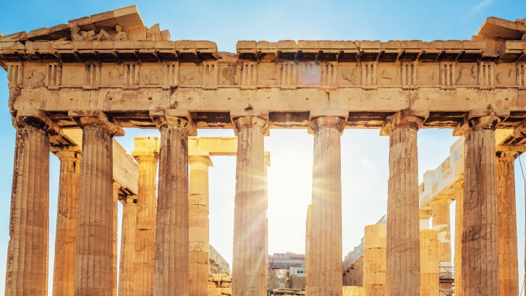
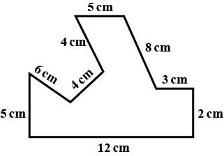
Task (LHS) Think Pair Share
The perimeter of this shape is 49cm. What was the process?

Slide 6

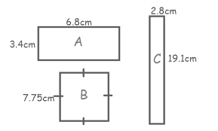
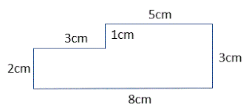
Complete these questions – draw them too!

Slide 7
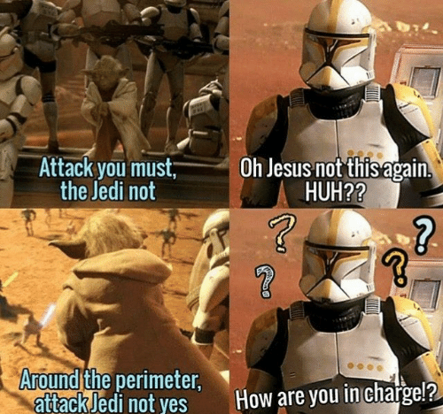
Origin of the word perimeter
Perimeter (n.)
The word 'perimeter' comes from two Greek words; peri, meaning 'around', and metron, meaning 'measure'. So perimeter means the measure or distance around something.
Notes:
Have post-it notes pre-prepared with -50, 25, 0, -75, 50, 75 for whole class display on the board

Slide 8
Task (LHS) Think Pair Share
As a class come up with 5 different things in the real world where Perimeter is used
1
2
3
4
5
Was this easy?
Notes:
e.g. Football Oval, House plans, School Boundary, Rocks around a garden, Desk, 2D Shapes, Basketball Court

Slide 9
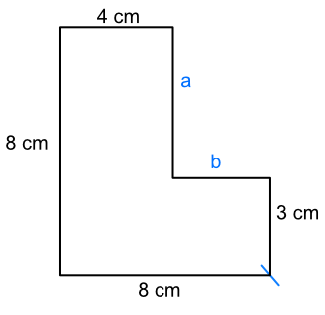
Task (LHS) Think Pair Share
What do you need to consider to consider when solving a question like this? What language would you use to describe the process?
Notes:
Have students lead the conversation. This summary they develop can be part of their summary at the end of the lesson

Slide 10
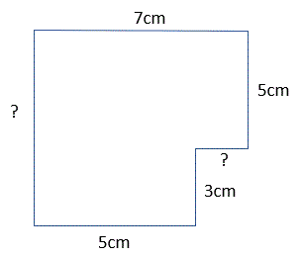
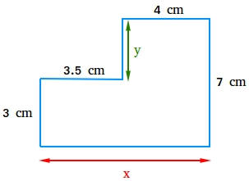
Complete these questions – draw them too!

Slide 11
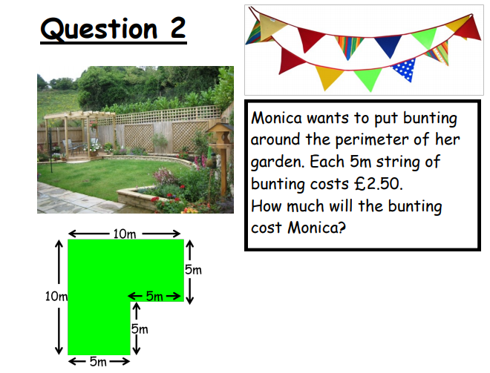
Task (LHS) Think Pair Share report writing
Copy into your books and think about what the process would be to complete this question? What steps are needed to consider?
Be prepared to share your answers

Slide 12
Task (LHS) Think Pair Share report writing
Copy into your books and think about what the process would be to complete this question? What steps are needed to consider?
Be prepared to share your answers
a) What is the perimeter of the Monica’s garden?
b) How many 5m strings must Monica buy?
c) How much will the bunting cost Monica?
Notes:
Solve this live with students with them doing all the work.

Slide 13
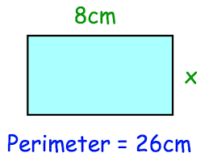

CHALLENGE TIME!
What is the process to find x?
Hint: What do you know?
Notes:
Create a similar question to extend.

Slide 14

Thank you
Keep up the good work!
Quote of the day –
“THE WAY I SEE IT, IF YOU WANT A RAINBOW, YOU HAVE TO PUT UP WITH THE RAIN”

